Slide 1
Too stressed out to care?
We all know that working in the addiction field can be stressful and if we don’t look after ourselves we risk getting burnt out.
This session will help develop self-care, leaving you better equipped to love yourself as much as those you care for (Mark 12v31).
Developing self-awareness re stress
Stress at work and long term stress
Managing stress
Recognising and dealing with burn-out

Slide 2

Developing self-awareness, in terms of self-care
What is stress?

Slide 3
Developing self-awareness, in terms of self-care
What is stress?
Stress is a state of being, not a health problem.
It is a physical response which is designed to prepare an individual for extraordinary physical action (fight or flight) – in a split second.
However, if stress is unchecked, too intense or prolonged, it can result in mental and physical illness.

Slide 4
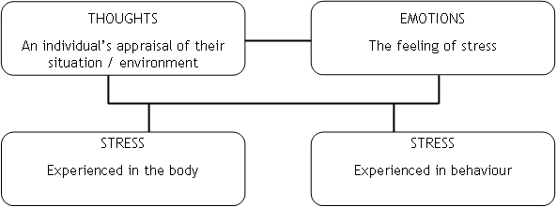
Diagram illustrating the relationship between thoughts, emotions, body and behaviour

Slide 5
Explaining the diagram
As we experience stress it can cause a feedback loop. Stress makes us more alert for threats, which can make us more sensitive to anything which might cause stress.
Different people react to situations differently - stress is not so much about the situation but more about how the individual perceives it.
A little mental exercise

Slide 6
What does stress look like?
Edginess
Wide eyes and pupil dilation
Pale face
Hair on end
Flared nostrils
Dry mouth
Faster breathing
Faster heartbeat
Butterflies
Tense muscles
Need to pass water

Slide 7
What does stress look like?
More sensitive to touch
Sweaty hands
Shaking
Less sensitive to pain
Feeling cold
Does any of this sound familiar?
Cortisol is a stress hormone, the main chemical released in response to stress. Sleep deprivation, caffeine, most stimulant drugs and alcohol all increase cortisol!

Slide 8
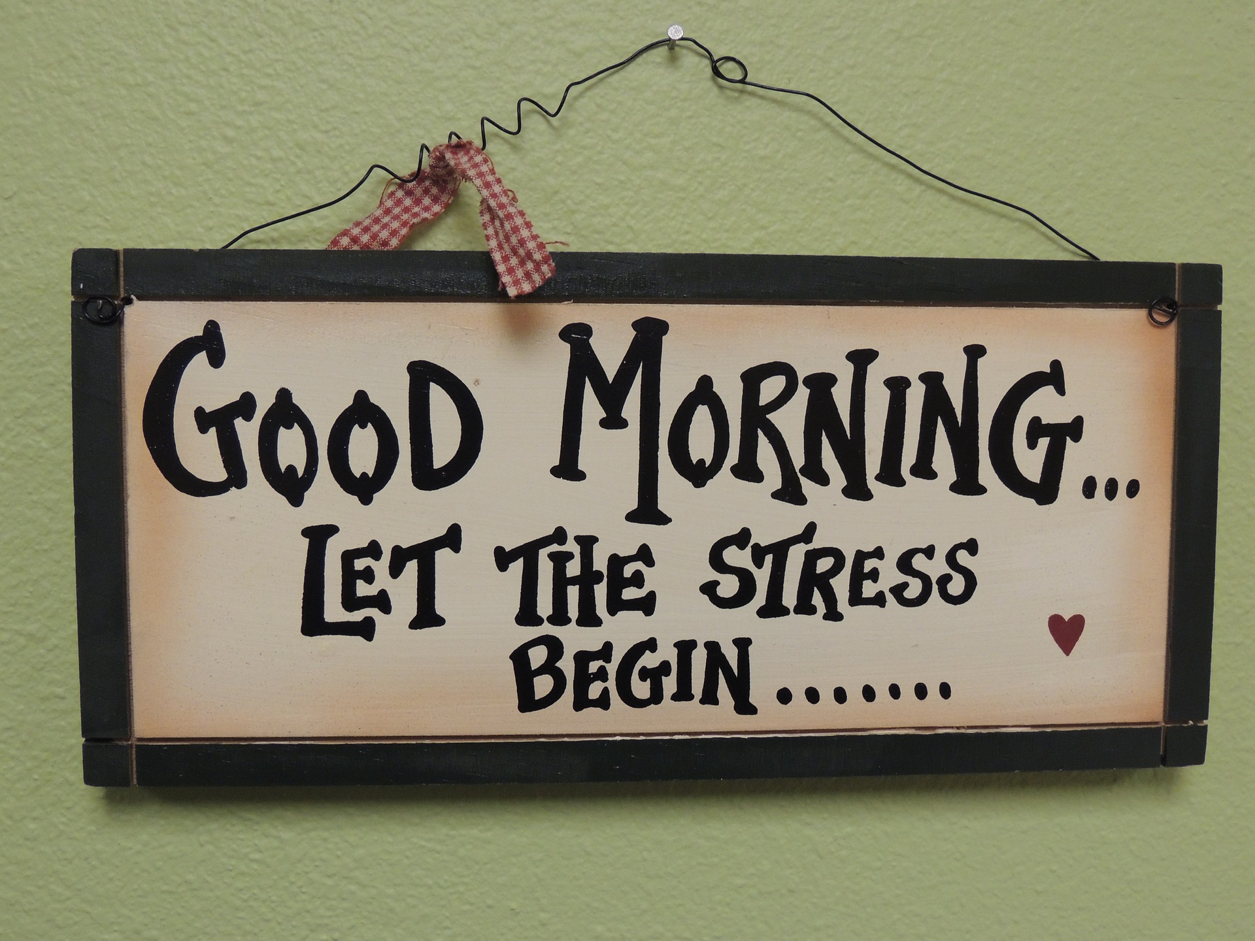
What is stress at work?

Slide 9
What is stress at work?
The Health and Safety Executive, the public body responsible for ensuring workplace health, safety and welfare, in England and Wales and Scotland, defines stress at work as follows:
"The adverse reaction people have to excessive pressures or other types of demand placed on them at work."
http://www.hse.gov.uk/stress/furtheradvice/whatisstress.htm
Reflect: What in particular makes you feel stressed in this work ie. where are you vulnerable?

Slide 10
What does long term stress look like?
Long term effects if stress is not dealt with (or dealt with using inappropriate coping mechanisms)
Headaches
Aches in the neck, shoulders, back and legs
Nerves, disturbed sleep
Skin conditions
Tension
Loss of appetite
Indigestion and ulcers
Poor circulation
Heart disease

Slide 11
Managing stress
Reflect: What are your personal stress factors or indicators? And how can/do you cope?
Examples of coping strategies
Withdrawal from the situation (necessary at times)
Relational – talking to a friend for support or confronting a person about the problem, prayer
Environmental – listen to music, soak in a warm bath, burn a scented candle
Physical – deep controlled breathing, exercising eg. walking, cycling, squash
Mental/emotional – crying, shouting, space to think, refocusing/reframing, meditation, sung worship
Spiritual – incorporated in the above

Slide 12
Managing stress
Our strategies will either exacerbate the stress, or alleviate it.
Do your current strategies help? Are there others that you think might work better?
Time for handout (see qs on next slide)
Remember stress deceives us into thinking we have no choice and we feel trapped, like a victim. “I’m damned if I do and I’m damned if I don’t”.
Let’s face the facts, accept reality and feel our feelings, but don’t stop there.
Then find faith through focusing on the truth about the situation, about ourselves, our feelings, about God and how he deals with and relates to us.

Slide 13
Managing stress
Answer the following qs. on your own
What in particular makes you feel stressed in this line of work ie. where are you vulnerable?
What are 3 of your personal stress factors or indicators you are stressed?
What are 3 of your current coping strategies and how well do they work for you?
What new coping strategy or strategies would you like to try and why?
What 2 things can you do to avoid the risk of burn out?
In pairs share 1 coping strategy that works for you now & 1 new coping strategy you are going to try and why.

Slide 14
Recognising and avoiding burnout
There are a number of models showing the progressive stages of burnout. The following is an amalgamation of the 4 stages of burnout http://www.stressdoc.com/four_stages_burnbout.htm, with an adaptation of Veninga and Spradley's (1981) model on burnout at work http://www.winona.edu/stress/bntstages.htm

Slide 15
Stages of burnout
1. Balancing Act – There is an imbalance between the demands of your job and your personal resources. You may be working longer hours, missing breaks and meals. You will notice an increase in the following:
job dissatisfaction
work inefficiency, including avoiding making necessary decisions, "losing" stuff at work (even on your desk!) etc
fatigue (a general fatigue, often accompanied by deep muscle fatigue)
sleep disturbances (often that you are so "busy" in your head that you can't get to sleep)
escapist activities of choice (including eating, drinking, smoking, zoning out in front of the TV, etc.

Slide 16
Stages of burnout
2. Pessimism and Doubt – about your situation and yourself.
The first stage symptoms are getting worse.
Feeling depressed about your current situation is accompanied with a lack of confidence about the future.
Thoughts that you are an imposter begin to dominate, and you may feel a sense of shame.
3. Cynicism and hard-heartedness - When feeling vulnerable or insecure is a continual experience we can become cynical and callous.
An attitude of self-protection becomes prevalent.

Slide 17
Stages of burnout
4. Crisis - Nobody can keep going at top speed, as the body and mind simply can’t cope.
Physical symptoms get worse and/or increase in number.
Small things feel very personal and you obsess about frustrations at work. You may feel “caught between the devil and the deep blue sea” but it is critical to stop before its too late.
You develop an "escapist mentality“.

Slide 18
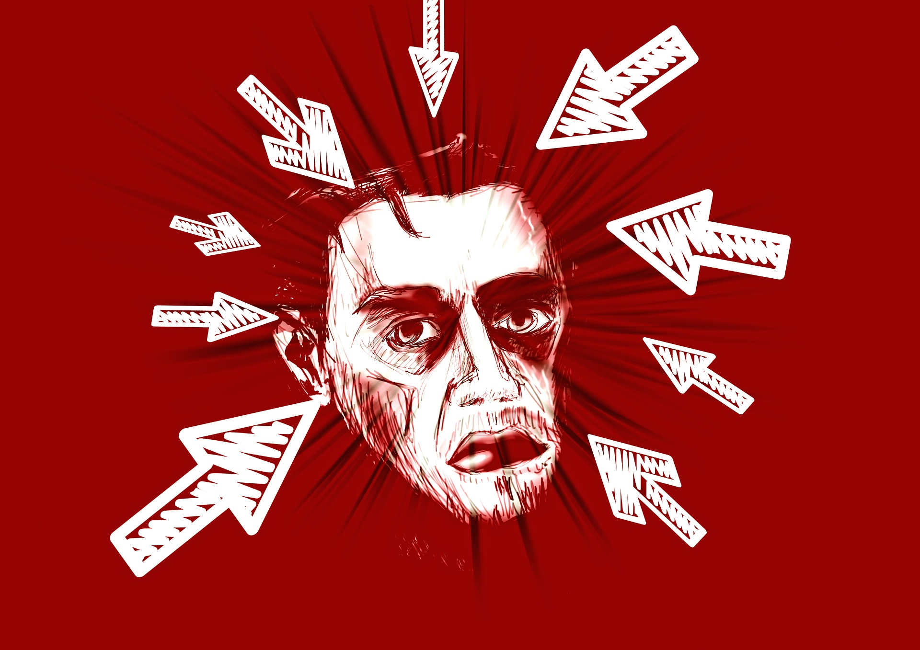

Slide 19
“Hey, before throwing up your hands, remember...burnout is not for wimps. A lot of other folks would have jumped ship much earlier. Many of you reach the farther stages of burnout because of your tenacity and dedication. You have a strong sense of responsibility and don't like being deterred from reaching your goals. All noble qualities...unless compelled by rigid perfectionism and "there's only one right way" thinking. Then, pursuing your goals takes a back seat to proving others wrong and overcoming humiliation. You are chasing (maybe, also, being chased by) ego-driven egoals. Especially in times of overload, uncertainty and major change, "driven and rigid responsibility" can quickly transform a performance benefit into a personal and professional liability.” Mark Gorkin, http://www.stressdoc.com/four_stages_burnbout.htm

Slide 20
Dealing with burnout
It is vital that we get help in a crisis, ideally from someone suitably trained and experienced.
Taking time off is essential, before we are forced into it.
We need to face our denial and confront our negative attitudes.
Acknowledge any loss or sense of failure we have experienced, and allow ourselves to grieve.
We may need to move on, but if not then we should use new found energy to generate solution-focused possibilities, and get skilled-up and resourced in order to turn these into reality.

Slide 21
Dealing with burnout
Food for thought:
"Burnout is less a sign of failure and more that you gave yourself away." Anon.
“Burnout does not result from working too hard. It results from doing what God has not called us to do, and therefore not given us the grace for” ?!? Phil Moore, GP

Slide 22
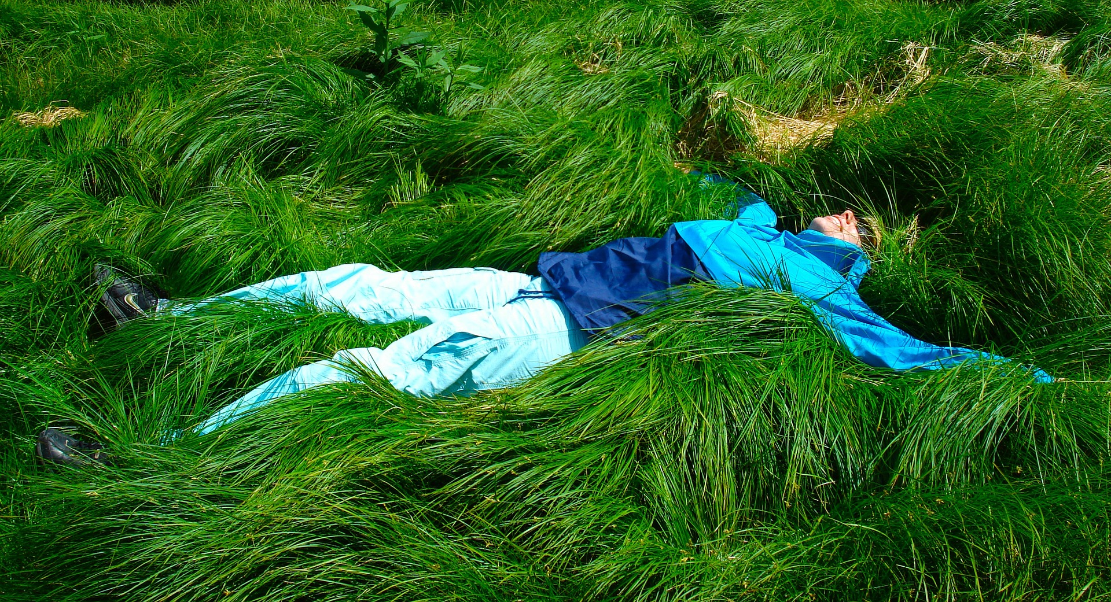
What we are aiming for?

Slide 23
Self care
When do you rest? When are you off duty?
How much time do you give to rest?
What do you do that nurtures you, that is just for you?
What makes you feel loved unconditionally, or when are you aware of feeling like that?
A visualisation exercise – Safe place / Psalm 23
Notes:
Personal issues can cause us to focus on ourselves rather than on the recovery needs of our client.

Slide 24
Psalm 23: A psalm of David.
¹ The Lord is my shepherd, I lack nothing.
² He makes me lie down in green pastures,
he leads me beside quiet waters,
³ he refreshes my soul.
He guides me along the right paths for his name’s sake.
⁴ Even though I walk through the darkest valley,
I will fear no evil, for you are with me;
your rod and your staff, they comfort me.
⁵ You prepare a table before me in the presence of my enemies.
You anoint my head with oil; my cup overflows.
⁶ Surely your goodness and love will follow me all the days of my life, and I will dwell in the house of the Lord
forever.

Slide 25
For further information and training, please contact Mark Wood at Addico Training and Development –
M: 07986 640840
E: mark.woody.wood@btinternet.com

